Slide 1
Blacktown Chinese Christian Church
Welcome to Our English Service 26.10.2025
English Service 9:45 – 11:00 am
Worship Songs: Passage: Speaker: Topic: Response Song: Announcements and Closing Prayer Benediction
He Is Lord He is Risen From The Dead Ancient of days Lord I need you Good good father James 1:1-18 Jenny Williams The A B C of James TBA

Slide 2
BCCC english service

Slide 3

Please keep all phones on silent

Slide 4
He Is Lord (Hymn)
CCLI Licence No: 5485849

Slide 5
He is Lord! He is Lord!
He is risen from the dead and He is Lord!
Ev'ry knee shall bow, ev'ry tongue confess
that Jesus Christ is Lord.

Slide 6
He is Lord! He is Lord!
He is risen from the dead and He is Lord!
Ev'ry knee shall bow, ev'ry tongue confess
that Jesus Christ is Lord.

Slide 7
He is Lord! He is Lord!
He is risen from the dead and He is Lord!
Ev'ry knee shall bow, ev'ry tongue confess
that Jesus Christ is Lord.

Slide 8
Ancient Of Days
Jesse Reeves, Jonny Robinson, Michael Farren, Rich Thompson © 2018 BEC Worship (Admin. by Essential Music Publishing LLC) CCLI Licence No. 5485849 . CCLI Song number: 7121851

Slide 9
Blessing and honor, glory and power
Be unto the ancient of days
From every nation, all of creation
Bow before the ancient of days

Slide 10
Every tongue in heaven and earth shall declare Your glory
Every knee shall bow at Your throne in worship
You will be exalted, oh, God
And Your kingdom shall not pass away

Slide 11
Oh, ancient of days

Slide 12
Blessing and honor, glory and power
Be unto the ancient of days
From every nation, all of creation
Bow before the ancient of days

Slide 13
Every tongue in heaven and earth shall declare Your glory
Every knee shall bow at Your throne in worship
You will be exalted, oh, God
And Your kingdom shall not pass away

Slide 14
Oh, ancient of days
Oh, ancient of days

Slide 15
Your kingdom shall reign over all the earth
Sing unto the ancient of days
For none can compare to Your matchless worth
Sing unto the ancient of days

Slide 16
Every tongue in heaven and earth shall declare Your glory
Every knee shall bow at Your throne in worship
You will be exalted, oh, God
And Your kingdom shall not pass away

Slide 17
Oh, ancient of days
Oh, ancient of days

Slide 18
Oh, your kingdom shall rain over all the earth
Sing unto the ancient of days
For none can compare to Your matchless worth
Sing unto the ancient of days

Slide 19
Oh, your kingdom shall rain over all the earth
Sing unto the ancient of days

Slide 20
Lord, I Need You
CCLI Licence No: 5485849

Slide 21
Lord I come, I confess
Bowing here I find my rest
Without You I fall apart
You're the one that guides my heart

Slide 22
Lord, I need You, oh I need You
Every hour I need You
My one defense, my righteousness
Oh God, how I need You

Slide 23
Where sin runs deep, Your grace is more
Where grace is found is where You are
And where You are Lord I am free
Holiness is Christ in me

Slide 24
Yes where You are Lord I am free
Holiness is Christ in me

Slide 25
Lord, I need You, oh I need You
Every hour I need You
My one defense, my righteousness
Oh God, how I need You

Slide 26
So teach my song to rise to You
When temptation comes my way
And when I cannot stand I'll fall on You
Jesus You're my hope and stay

Slide 27
And when I cannot stand I'll fall on You
Jesus You're my hope and stay

Slide 28
Lord, I need You, oh I need You
Every hour I need You
My one defense, my righteousness
Oh God, how I need You

Slide 29
Lord, I need You, oh I need You
Every hour I need You
My one defense, my righteousness
Oh God, how I need You

Slide 30
Good Good Father
Anthony Brown, Pat Barrett © 2014 Capitol CMG Paragon (Admin. by SHOUT! Music Publishing Australia) Common Hymnal Digital (Admin. by SHOUT! Music Publishing Australia) CCLI Licence No. 5485849 . CCLI Song number: 7036612

Slide 31
Oh I've heard a thousand stories of
What they think You're like
But I've heard the tender whisper of
Love in the dead of night

Slide 32
And You tell me that You're pleased
And that I'm never alone

Slide 33
You're a Good, Good Father
It's who You are
It's who You are
It's who You are

Slide 34
And I'm loved by You
It's who I am
It's who I am
It's who I am

Slide 35
Oh I've seen many searching for answers far and wide
But I know we're all searching
For answers only You provide
Cause You know just what we need, before we say a word

Slide 36
You're a Good, Good Father
It's who You are
It's who You are
It's who You are

Slide 37
And I'm loved by You
It's who I am
It's who I am
It's who I am

Slide 38
You are perfect in all of Your ways
You are perfect in all of Your ways
You are perfect in all of Your ways
To us

Slide 39
You are perfect in all of Your ways
You are perfect in all of Your ways
You are perfect in all of Your ways
To us

Slide 40
Oh, it's love so undeniable
I, I can hardly speak
Peace so unexplainable
I, I can hardly think

Slide 41
As You call me deeper still
As You call me deeper still
As You call me deeper still
Into love, love, love

Slide 42
You're a Good, Good Father
It's who You are
It's who You are
It's who You are

Slide 43
And I'm loved by You
It's who I am
It's who I am
It's who I am

Slide 44
You're a Good, Good Father
It's who You are
It's who You are
It's who You are

Slide 45
And I'm loved by You
It's who I am
It's who I am
It's who I am

Slide 46
You're a Good, Good Father
It's who You are
It's who You are
It's who You are

Slide 47
And I'm loved by You
It's who I am
It's who I am
It's who I am

Slide 48
You are perfect in all of Your ways
You are perfect in all of Your ways
You are perfect in all of Your ways
To us

Slide 49
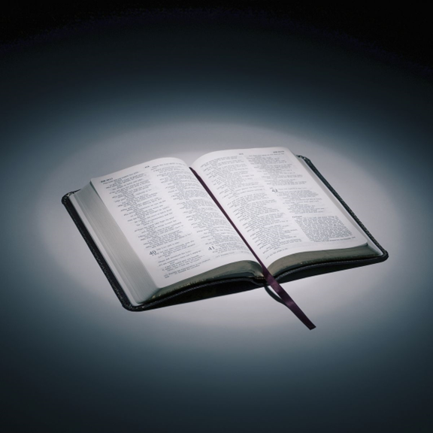
Bible reading

Slide 50
James 1:1-18
James, a servant of God and of the Lord Jesus Christ,
To the twelve tribes scattered among the nations:
Greetings.
² Consider it pure joy, my brothers and sisters, whenever you face trials of many kinds,

Slide 51
James 1:1-18
³ because you know that the testing of your faith produces perseverance. ⁴ Let perseverance finish its work so that you may be mature and complete, not lacking anything.

Slide 52
James 1:1-18
⁵ If any of you lacks wisdom, you should ask God, who gives generously to all without finding fault, and it will be given to you. ⁶ But when you ask, you must believe and not doubt, because the one who doubts is like a wave of the sea, blown and tossed by the wind.

Slide 53
James 1:1-18
⁷ That person should not expect to receive anything from the Lord. ⁸ Such a person is double-minded and unstable in all they do.

Slide 54
James 1:1-18
⁹ Believers in humble circumstances ought to take pride in their high position. ¹⁰ But the rich should take pride in their humiliation—since they will pass away like a wild flower.

Slide 55
James 1:1-18
¹¹ For the sun rises with scorching heat and withers the plant; its blossom falls and its beauty is destroyed. In the same way, the rich will fade away even while they go about their business.
¹² Blessed is the one who perseveres under trial because, having stood the test, that person will receive the crown of life that the Lord has promised to those who love him.

Slide 56
James 1:1-18
¹³ When tempted, no one should say, “God is tempting me.” For God cannot be tempted by evil, nor does he tempt anyone; ¹⁴ but each person is tempted when they are dragged away by their own evil desire and enticed.

Slide 57
James 1:1-18
¹⁵ Then, after desire has conceived, it gives birth to sin; and sin, when it is full-grown, gives birth to death.
¹⁶ Don’t be deceived, my dear brothers and sisters.

Slide 58
James 1:1-18
¹⁷ Every good and perfect gift is from above, coming down from the Father of the heavenly lights, who does not change like shifting shadows. ¹⁸ He chose to give us birth through the word of truth, that we might be a kind of firstfruits of all he created.

Slide 59
Announcements

Slide 60





Account name: Blacktown Chinese Christian Church
Account number: 4216 50263
Offering
BSB: 112 - 879
Please put in "offering" as the reference
The offering box is available at the back of the hall

Slide 61
Prayer points

Slide 62
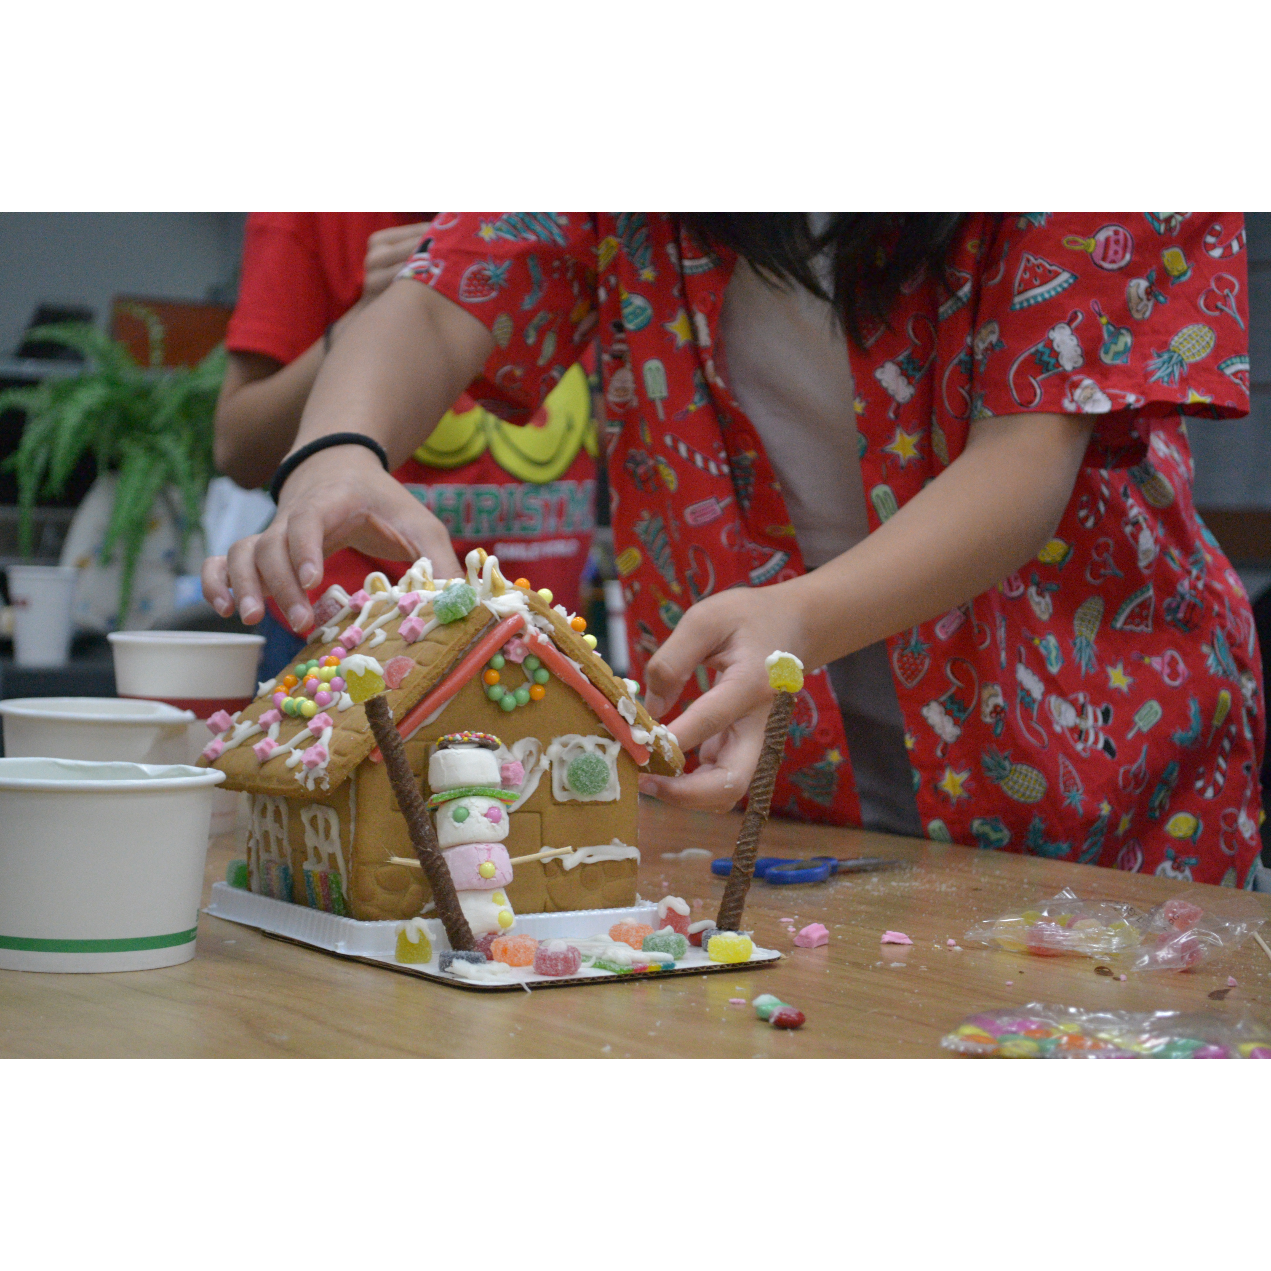
Mingle time!

