Slide 1
Blacktown Chinese Christian Church
Welcome to Our English Service 07.12.2025
English Service 9:45 – 11:00 am
Worship Songs: Passage: Speaker: Topic: Response Song: Announcements and Closing Prayer Benediction
Our God Amazing Grace (My Chains Are Gone) I Surrender All Christ is Enough 2 Corinthians 12:3-5 Sylvia Ting The God Who Leads TBA

Slide 2
BCCC english service

Slide 3

Please keep all phones on silent

Slide 4
Our God
CCLI Licence No: 5485849

Slide 5
Water You turned into wine
Opened the eyes of the blind
There's no one like You
None like You

Slide 6
Into the darkness, You shine
Out of the ashes, we rise
There's no one like You
None like You!

Slide 7
Our God is greater, our God is stronger
God, You are higher than any other
Our God is healer, awesome in power
Our God, our God

Slide 8
Into the darkness, You shine
Out of the ashes, we rise
There's no one like You
None like You!

Slide 9
Our God is greater, our God is stronger
God, You are higher than any other
Our God is healer, awesome in power
Our God, our God (x2)

Slide 10
And if our God is for us, then who could ever stop us
And if our God is with us, then what could stand against

Slide 11
And if our God is for us, then who could ever stop us
And if our God is with us, then what could stand against
Then what could stand against!

Slide 12
Our God is greater, our God is stronger
God, You are higher than any other
Our God is healer, awesome in power
Our God, our God

Slide 13
Our God is greater, our God is stronger
God, You are higher than any other
Our God is healer, awesome in power
Our God, our God!

Slide 15
And if our God is for us, then who could ever stop us
And if our God is with us, then what could stand against
And if our God is for us, then who could ever stop us
And if our God is with us, then what could stand against!

Slide 16
Then what could stand against!
What could stand against!

Slide 17
Amazing Grace (My Chains Are Gone)
CCLI Licence No: 5485849

Slide 18
Amazing grace, how sweet the sound
That saved a wretch like me
I once was lost, but now I'm found
Was blind, but now I see

Slide 19
'Twas grace that taught my heart to fear
And grace my fears relieved
How precious did that grace appear
The hour I first believed

Slide 20
My chains are gone, I've been set free
My God, my Savior has ransomed me
And like a flood His mercy reigns
Unending love, amazing grace

Slide 21
The Lord has promised good to me
His word my hope secures
He will my shield and portion be
As long as life endures

Slide 22
My chains are gone, I've been set free
My God, my Savior has ransomed me
And like a flood His mercy reigns
Unending love, amazing grace (x2)

Slide 23
The earth shall soon dissolve like snow
The sun forbear to shine
But God who called me here below
Will be forever mine

Slide 24
Will be forever mine
You are forever mine

Slide 25
I Surrender All
CCLI Licence No: 5485849

Slide 26
All to Jesus I surrender
All to him I freely give;
I will ever love and trust him
In his presence daily live

Slide 27
I surrender all
I surrender all
All to thee, my blessed Savior
I surrender all

Slide 28
All to Jesus I surrender;
Make me, Savior, wholly thine;
Let me feel the Holy Spirit
Truly know that thou art mine

Slide 29
I surrender all
I surrender all
All to thee, my blessed Savior
I surrender all

Slide 30
All to Jesus I surrender;
Now I feel the sacred flame
Oh, the joy of full salvation!
Glory, glory, to his name!

Slide 31
I surrender all
Oh, I surrender all
All to thee, my blessed Savior
I surrender all

Slide 32
Oh, I surrender all
Oh, I surrender

Slide 33
Christ Is Enough
CCLI Licence No: 5485849

Slide 34
Christ is my reward
And all of my devotion
Now there's nothing in this world
That could ever satisfy

Slide 35
Through every trial, my soul will sing
No turning back, I’ve been set free

Slide 36
Christ is enough for me
Christ is enough for me
Everything I need is in You
Everything I need

Slide 37
Christ my all in all
The joy of my salvation
And this hope will never fail
Heaven is our home

Slide 38
Through every storm, my soul will sing
Jesus is here, to God be the glory

Slide 39
Christ is enough for me
Christ is enough for me
Everything I need is in You
Everything I need

Slide 40
I have decided to follow Jesus
No turning back, no turning back
I have decided to follow Jesus
No turning back, no turning back

Slide 41
The cross before me, the world behind me
No turning back, no turning back
The cross before me, the world behind me
No turning back, no turning back

Slide 42
Christ is enough for me
Christ is enough for me
Everything I need is in You
Everything I need

Slide 43
Christ is enough for me
Christ is enough for me
Everything I need is in You
Everything I need

Slide 44
I have decided to follow Jesus
No turning back, no turning back
I have decided to follow Jesus
No turning back, no turning back

Slide 45
I have decided to follow Jesus
No turning back, no turning back
I have decided to follow Jesus
No turning back, no turning back

Slide 46
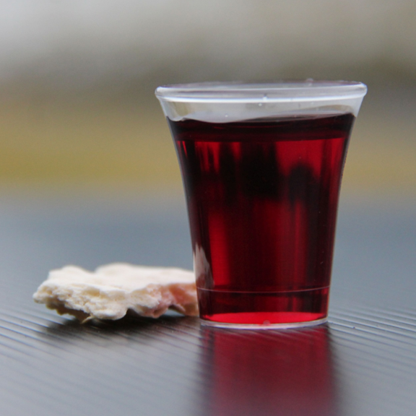
Holy Communion

Slide 47

Bible reading

Slide 48
2 Corinthians 12:3-5
³ And I know that this man—whether in the body or apart from the body I do not know, but God knows— ⁴ was caught up to paradise and heard inexpressible things, things that no one is permitted to tell.

Slide 49
2 Corinthians 12:3-5
⁵ I will boast about a man like that, but I will not boast about myself, except about my weaknesses.

Slide 50
Announcements

Slide 51





Account name: Blacktown Chinese Christian Church
Account number: 4216 50263
Offering
BSB: 112 - 879
Please put in "offering" as the reference
The offering box is available at the back of the hall

Slide 52
Prayer points

Slide 53
Mingle time!

